Slide 1

Reading Workshop

Slide 2



What are your own experiences of reading?

Slide 3
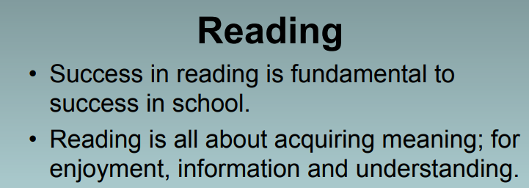


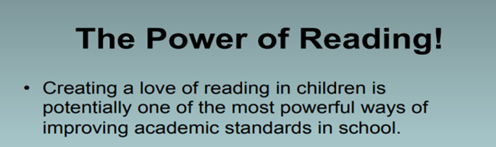

Slide 4
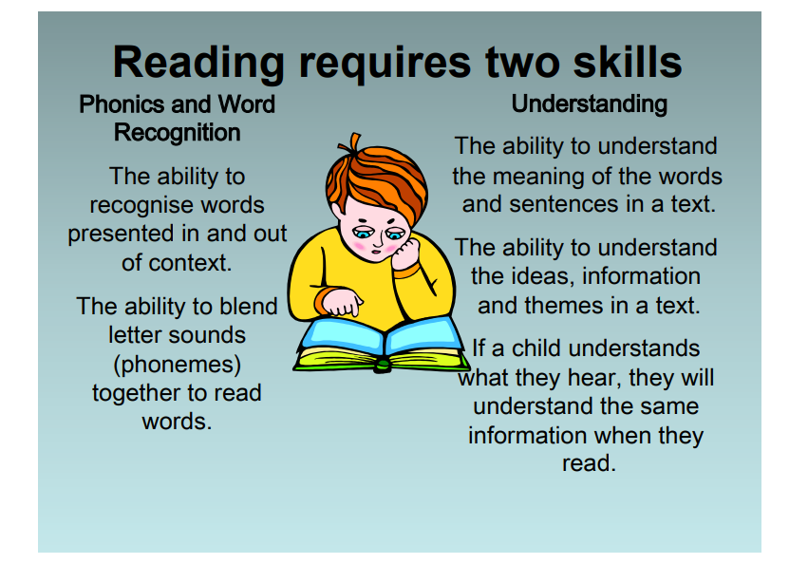

Slide 5
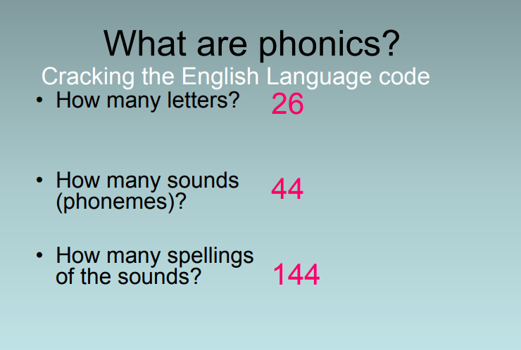

Slide 6


How to help your child learn the Read Write Inc. phonics sounds. First of all, you need to be able to say the sounds yourself.
How to help your child learn the Read Write Inc. phonics sounds
https://www.youtube.com/watch?v=KUbrJPAt65g

Slide 7
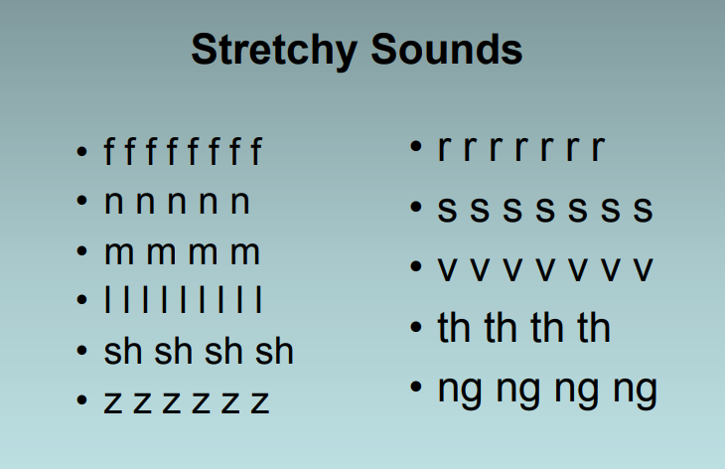

Slide 8
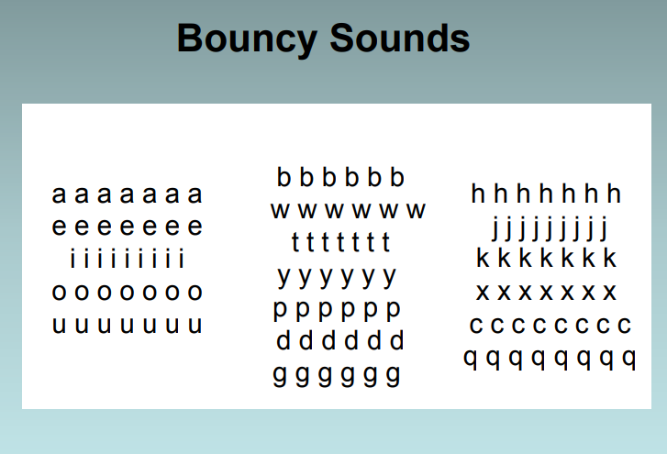

Slide 9
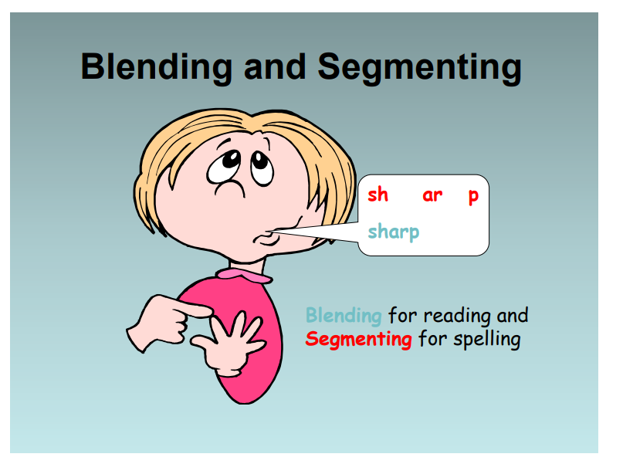

Slide 10
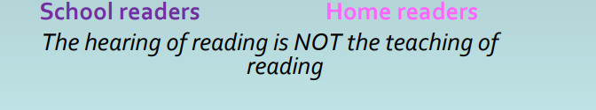
Reading in School
(The teaching of reading)
-Read, Write inc groups
-Fred’s Teaching group
-Sharing whole class text
-Shared reading
-Focused reading activities
-Reading across the curriculum

Slide 11
Reading books- How can you help?

Slide 12
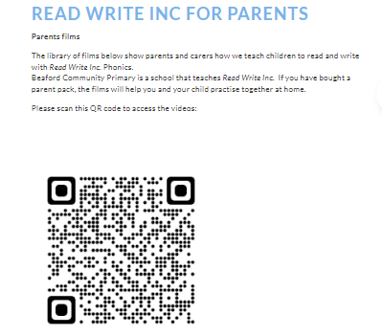
READ WRITE INC FOR PARENTS
Parents films
The library of films below show parents and carers how we teach children to read and write with Read Write Inc. Phonics.

Slide 13
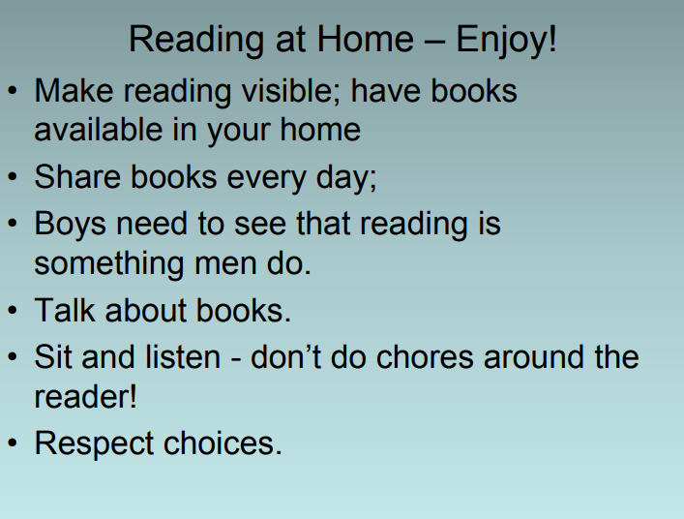

Slide 14
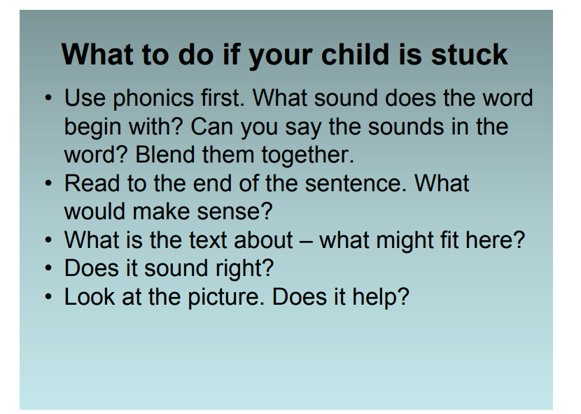

Slide 15
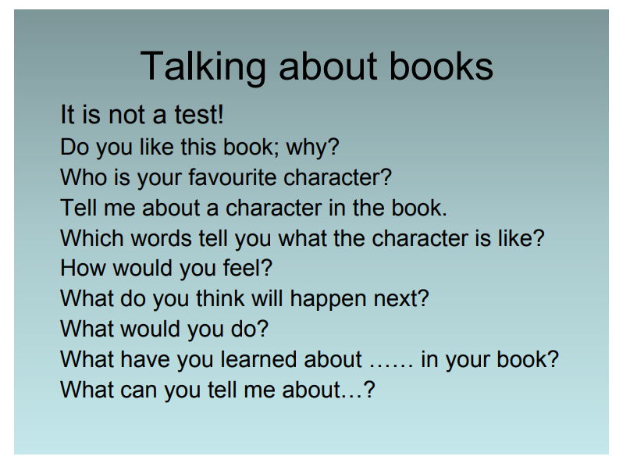

Slide 16
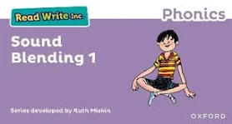

Ladybirds
Hedgehogs
Sound blending books have just started to come home in book bags. When your child is ready.
Handwriting sheet- daily set one sound.
RWI books sent home (the purpose is for the children to read these books effortlessly on the third read to empower them)
Accelerated reader (quiz to be done once a week in school).
Please make sure your child understands what they are reading.

Slide 17

Any questions?

